Slide 1
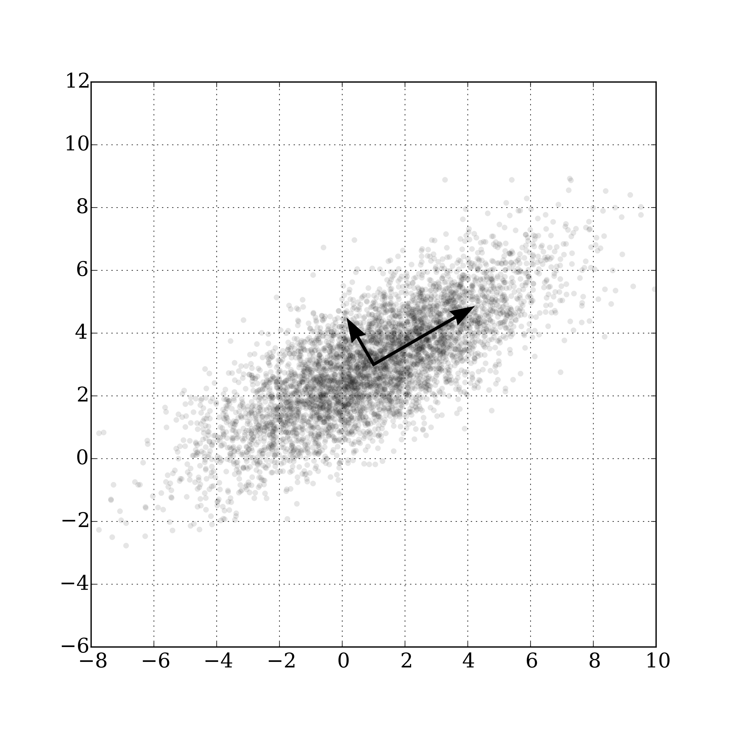
Welcome to Section
Principal Component Analysis
Section 8 – May 22, 2024

Slide 2

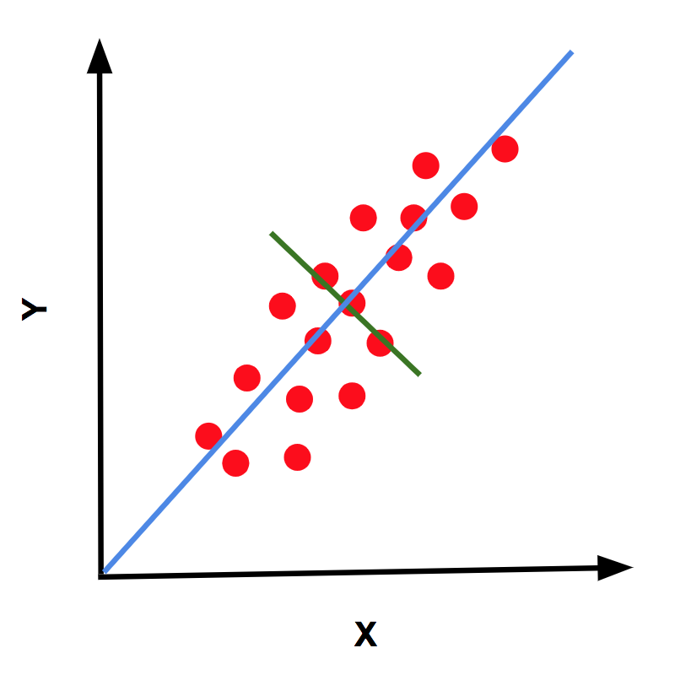
Agenda
Announcements
Review
Principal Component Analysis
Matrix Factorization
Ed notebook tutorial

Slide 3
Announcements
May 23 - HW6 Due Today
LR7, LR8, HW7 - Remaining Submissions with current Section notebook
June 3 @ 6 pm - Final Exam :))

Slide 4
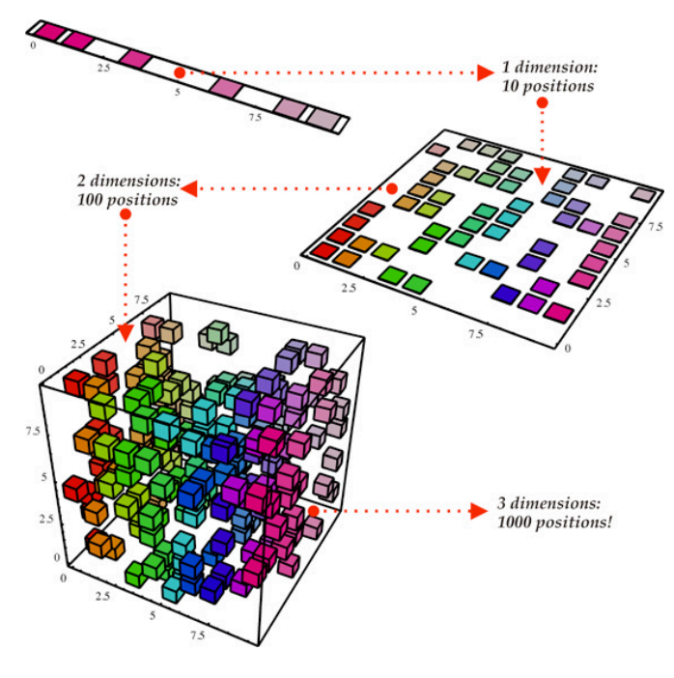
Dimensionality
Dimensionality Reduction: the task of representing the data with a fewer number of dimensions, while keeping meaningful relations between data
Easier Learning: fewer parameters, no curse of dimensionality
Visualization: Hard to visualize more than 3D
Discover “intrinsic dimensionality” of the data
High dimensional data is can sometimes be truly lower dimensional (i.e. redundant information)
Notes:
The task of representing the data with a fewer number of dimensions while keeping meaningful relations between data.
Oftentimes, we do this because it means learning fewer parameters and there is no curse of dimensionality.
In simple terms, the curse of dimensionality occurs when the number of features or dimensions in a dataset increases, leading to a sparsity problem and an exponential increase in the amount of data required to maintain a similar level of representation.
In addition, we can use it for visualization of the data itself. For example, how would we visualize a dataset with 10 features?
High dimensional data can sometimes be truly lower dimensional and contain redundant information, and dimensionality reduction can improve this aspect.

Slide 5
Principal Component Analysis
Idea: Use a linear projection from 𝑑-dimensional data to 𝑘-dimensional data, where d > k
1000-dimensional word vectors to 3-dimensional
Choose the projection that minimizes reconstruction error
Intuition: The information lost if you were to ”undo” the projection can give us meaningful information
Notes:
Specifically, we discussed PCA. The idea was to use a linear projection from d-dimensional data to k-dimensional data where d > k.
For instance, 1000d data to 3d data.Then you choose the projection that minimizes reconstruction error. The intuition with reconstruction error is to minimize the amount of information lost if you were to undo the projection.
Reconstruction error is the difference between original data and its reconstructed form using PCA

Slide 6
PCA Algorithm
Input Data: An n×𝑑 data matrix 𝑋
Algorithm:
1. Recenter Data: Subtract mean from each row
2. Compute spread/orientation: Compute covariance matrix Σ
3. Find basis for orientation: Compute eigenvectors of Σ
Select 𝑘 eigenvectors 𝑢1, … , 𝑢𝑘 with largest eigenvalues, usually using SVD (explore here)
4. Project Data: Project data onto principal
Notes:
Input Data: An n×𝑑 data matrix 𝑋
Algorithm:
1. Recenter Data: Subtract mean from each row
2. Compute spread/orientation: Compute covariance matrix Σ
Covariance matrix represents the relationship between features in the dataset
3. Find basis for orientation: Compute eigenvectors of Σ
Select 𝑘 eigenvectors 𝑢1, … , 𝑢𝑘 with largest eigenvalues, usually using SVD (explore here)
Eigenvectors represent the directions along which the data varies the most
4. Project Data: Project data onto principal
Large eigenvalues capture the most amount of information

Slide 7
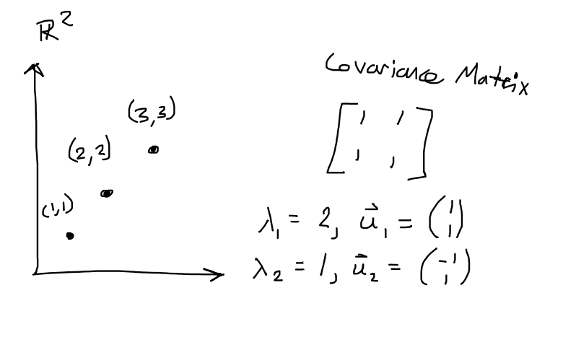
PCA Practice Question
Question: To minimize reconstruction error, which eigenvalue / eigenvector pair would we choose?
Notes:
ANS: l1 = 2 w/ v1 = (1, 1) bc we want to choose the largest eigenvalue since it is giving us the most prominent feature in the data

Slide 8
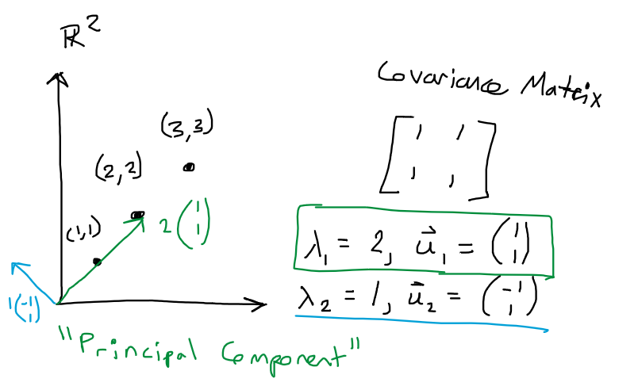
PCA Practice Question
Answer: choose the principal component
For non-square matrices, Singular Value Decomposition
Notes:
ANS: l1 = 2 w/ v1 = (1, 1) bc we want to choose the largest eigenvalue since it is giving us the most prominent feature in the data

Slide 9
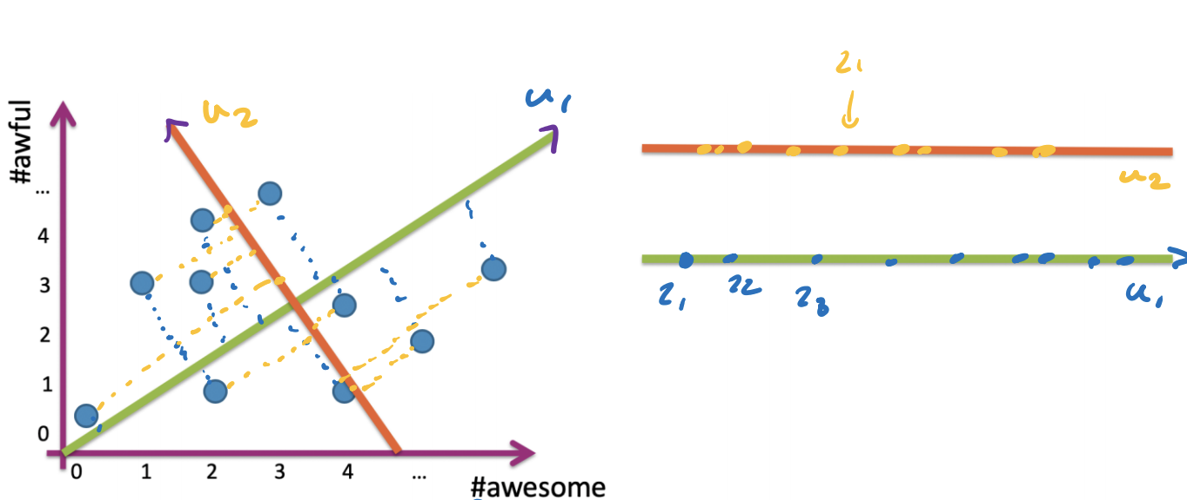
PCA Example
Notes:
pick the vector along which datapoints have most variation

Slide 10
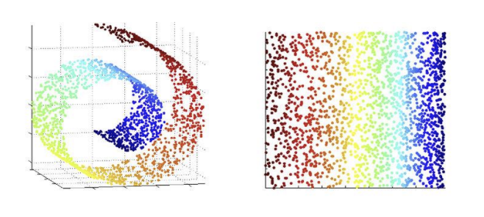
PCA Failures
Assumption: there is a representative lower dimensional linear subspace
May be invalid
May want to investigate non-linear dimensionality reduction
Manifold learning
Popular: SDD Maps, Isomap, LLE, t-SNE
Notes:
manifold learning -> non linear dimensionality reduction
PCA is a linear dimensionality reduction technique. It operates under the assumption that the underlying structure in the data can be captured by linear combinations of the original features.

Slide 11
Matrix Completion
Task: recommend movies based on user ratings for movies
Challenge: Users have rated few of the entire catalog (Sparse Matrix)
Assumptions for Matrix Completion:
There are 𝑘 types of movies (action, romance) which users have various interests in
This means we can describe a movie 𝒗 with feature vector 𝑹v
We can describe each user 𝒖 with a feature vector 𝑳u
Notes:
Matrix completion is a problem in which missing or incomplete entries of a matrix are estimated or filled in based on the observed entries. The goal is to recover the complete matrix by utilizing the available information.

Slide 12
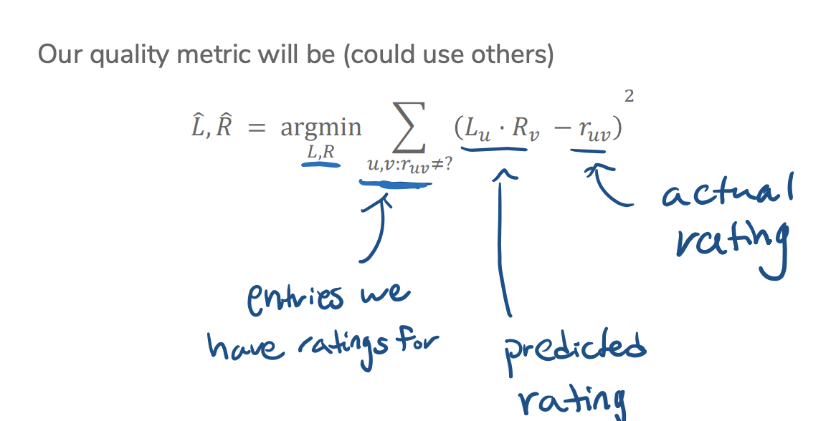
Matrix Factorization
Find 𝐿 and 𝑅 that when multiplied, achieve predicted ratings that are close to the values that we have data for.

Slide 13
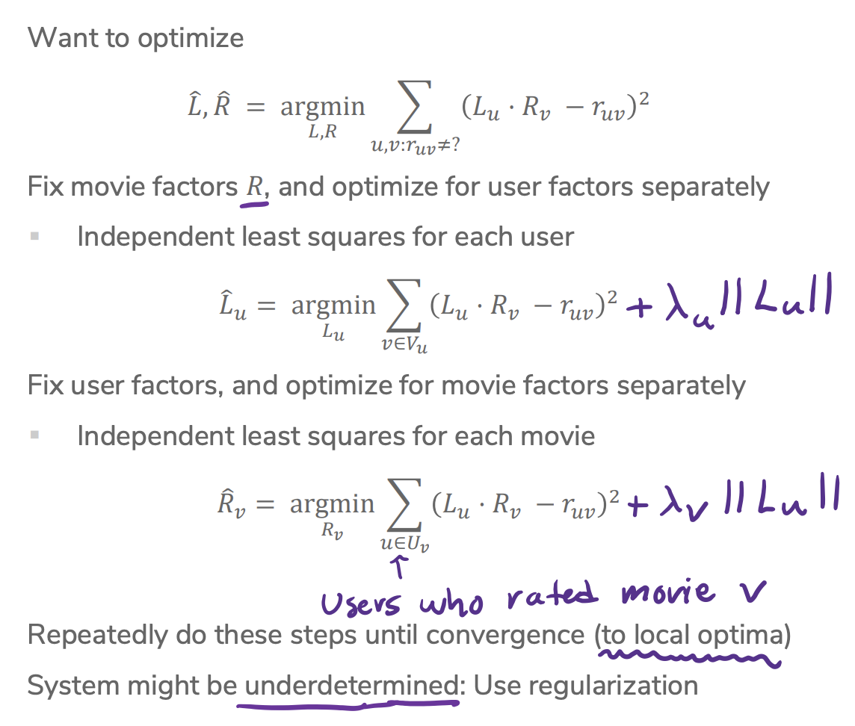
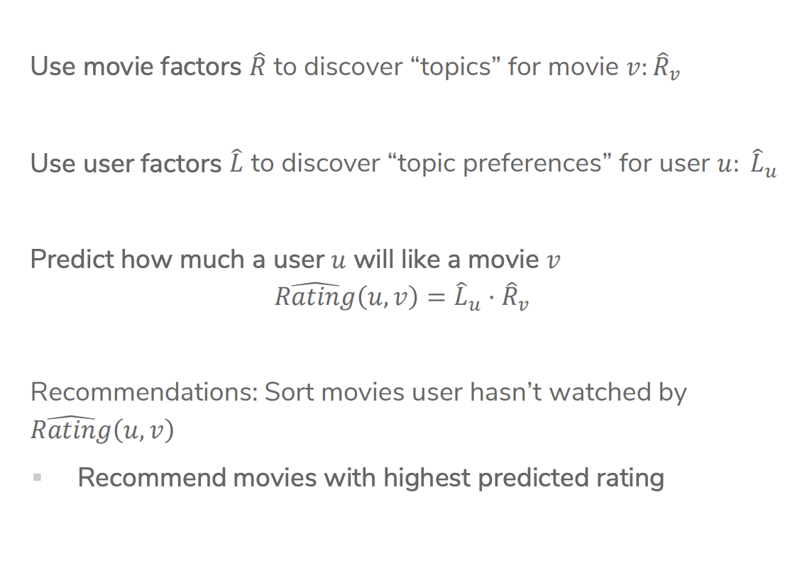
Coordinate Descent
Issue: No unique solution for determining L and R
Use coordinate descent to optimize for one coordinate at a time

Slide 14
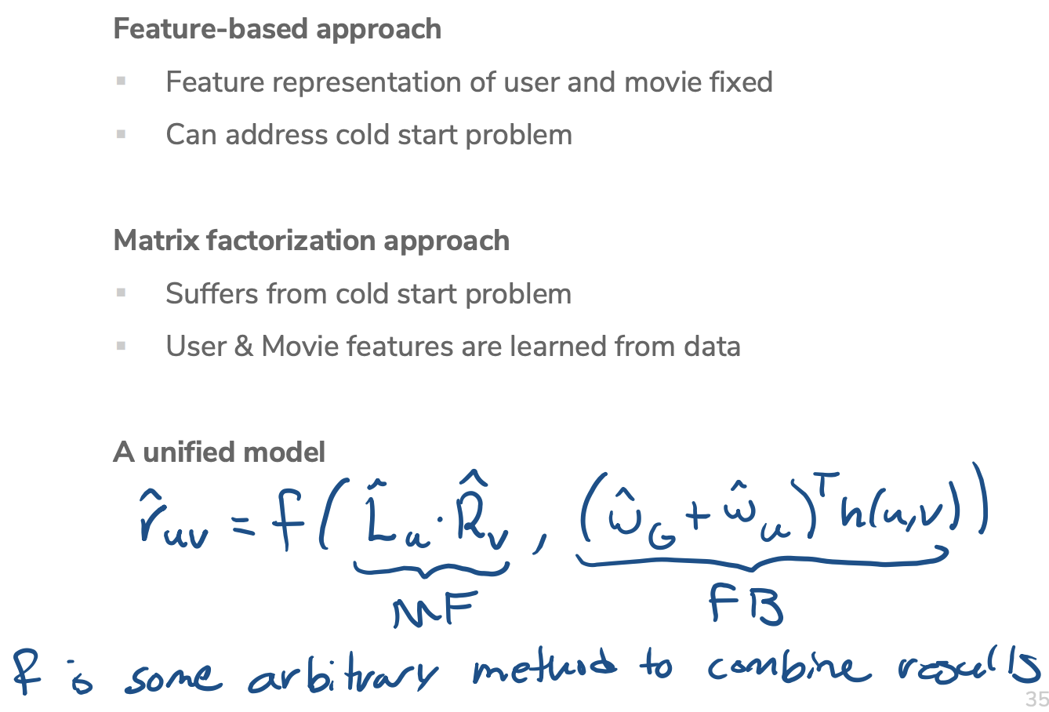
Cold Start & Blended Model
Now consider we have a new user and want to give personalized recommendations based on their preferences
Solution: Blended Model/Featurized Matrix Factorization
Idea: Learn a model to supplement the matrix factorization model

Slide 15
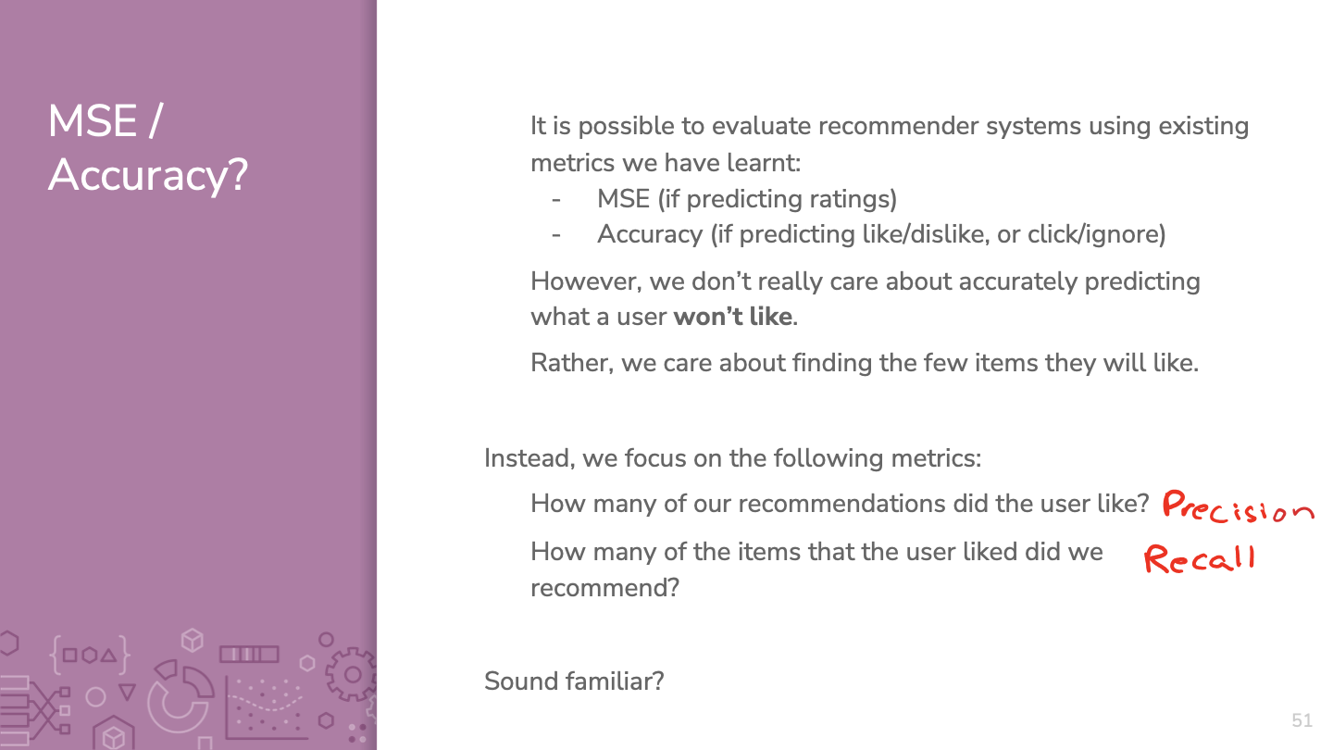
Cold Start & Blended Model
Now consider we have a new user and want to give personalized recommendations based on their preferences
Solution: Blended Model/Featurized Matrix Factorization
Idea: Learn a model to supplement the matrix factorization model
Notes:
How do we evaluate recommender systems?
Can use MSE/RSS/Accuracy but we typically use precision and recall

Slide 16
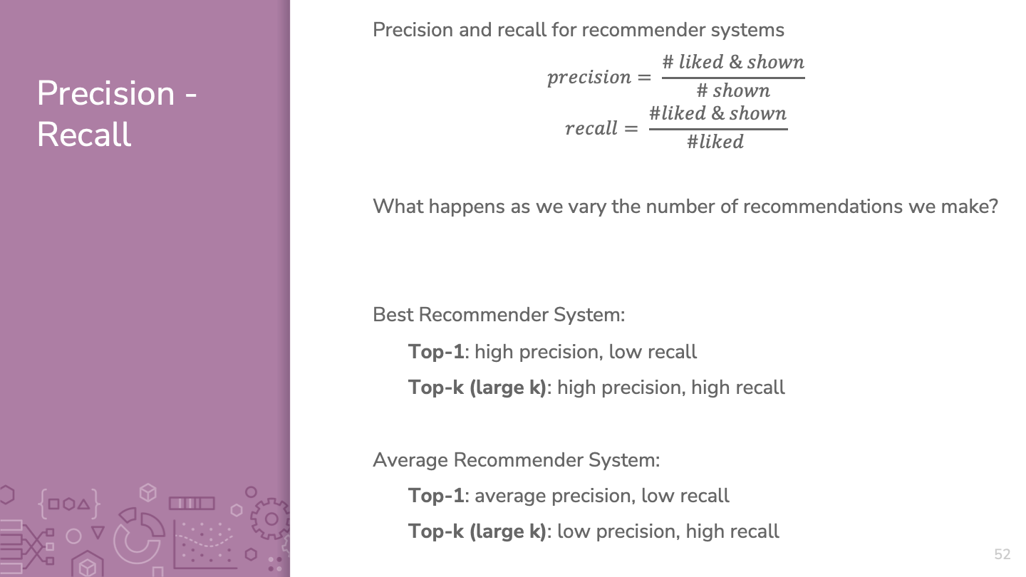
Notes:
●In general, as we increase the number of recommendations, the precision goes down but the recall goes up. This is a general trend, it could vary locally.

Slide 17
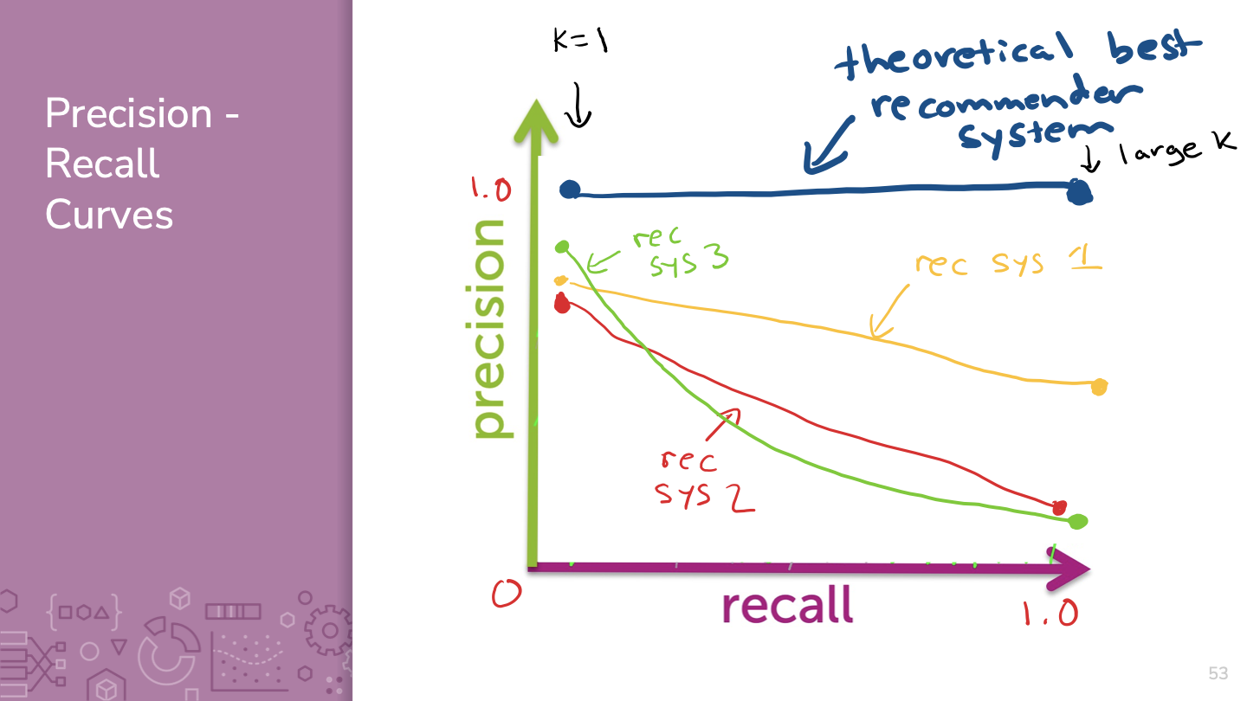
Notes:
●WOS:
○Optimal curve
○Some other curve

Slide 18
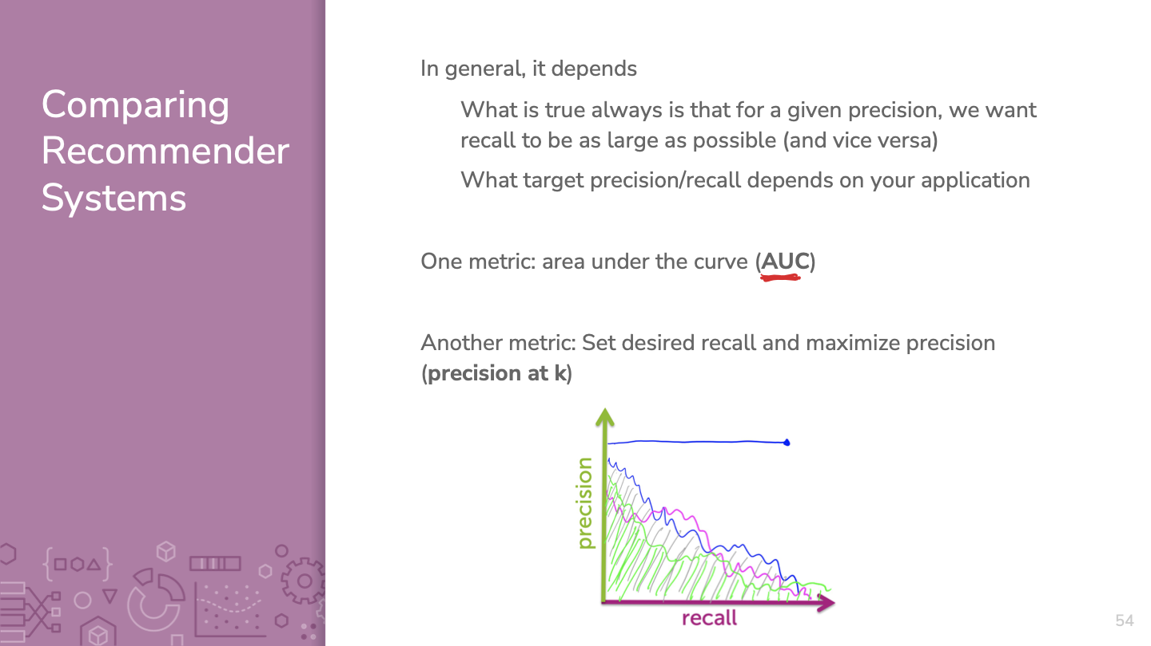

Slide 19
Matrix Factorization Practice Question
When doing matrix factorization, how do we find the best “k” latent factors?
Notes:
ANS: Hold out some of the input ratings as a validation set and try multiple values of k, choosing the one that minimizes validation error

Slide 20

Ed Notebook
https://edstem.org/us/courses/56859/lessons/98881/slides/546934

Slide 21
Final Study Tips
Next quiz section will be entirely focused on final review
Please bring questions/topics you would like me to discuss next week

